Slide 1


Email Spam Detection using Multinomial Naive Bayes
Submitted By:
G.M.S.M.Meghana - O210074
P.Gnana Deepika - O210169

Slide 2


Introduction
Spam Messages Overview: Spam messages represent unsolicited, unwanted communication sent in bulk across electronic mail and messaging channels.
Security Risks: They frequently contain fraudulent offers, malicious advertising, phishing schemes, and malware delivery vectors.
Role of Machine Learning: Automated Machine Learning algorithms analyze message semantics and patterns to reliably identify and isolate spam in real time.

Slide 3




Problem Statement
The Problem
The Proposed Solution
Users daily receive an overwhelming volume of unsolicited spam messages and phishing attempts.
Develop an intelligent Machine Learning model to automatically classify messages as Spam or Not Spam (Ham).
High risk of privacy breaches & financial scams.
Leverages Natural Language Processing (NLP).
Decreased workplace efficiency & cluttered inboxes.
Utilizes Multinomial Naive Bayes probabilistic model.
Traditional rule-based filters fail against evolving spam phrases.
Provides fast, scalable, and high-accuracy filtering.

Slide 4








Project Objectives
Automated Detection
Enhance Security
Reduce Noise
Master ML & NLP
Detect and classify spam messages automatically without requiring manual intervention.
Improve inbox and digital communication security against fraud, malware, and phishing links.
Significantly reduce unwanted and distracting messages to deliver a clean communication channel.
Gain practical expertise in text preprocessing, TF-IDF vectorization, and supervised ML classification.

Slide 5
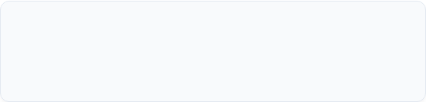
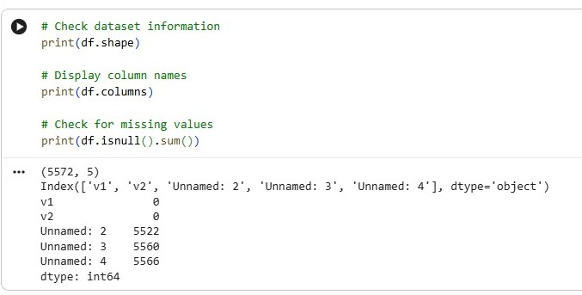
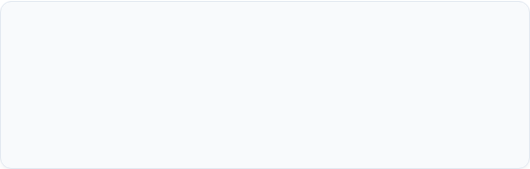
Dataset Overview
Dataset Details
Dataset Name: SMS Spam Collection Dataset
Total Sample Size: 5,572 labeled messages
Target Classes
Spam: Fraudulent / Unsolicited promotional texts
Ham: Legitimate, personal, or regular work messages

Slide 6

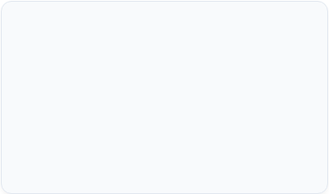










Tools & Technologies
Google Colab
Python 3
Pandas
Cloud-based interactive development environment with free CPU/GPU computing power.
Core programming language utilized for data manipulation, scripting, and machine learning.
High-performance data manipulation and analysis library for structured dataset operations.
Scikit-Learn
TF-IDF Vectorizer
Multinomial Naive Bayes
Robust Python framework providing machine learning models, metrics, and data splitters.
Converts raw text into numerical feature vectors based on Term Frequency-Inverse Document Frequency.
Probabilistic classification model optimized for discrete word frequency features.

Slide 7







System Methodology
Dataset Collection
Data Cleaning
TF-IDF Vectorization
Train / Test Split
Naive Bayes Model
Prediction
Accuracy Evaluation
Methodology Execution Note:
The dataset is cleaned by removing noise, stop words, and special characters. TF-IDF transforms textual words into numerical importance vectors. The dataset is split into training and testing sets before being fitted to the Multinomial Naive Bayes model.

Slide 8




Multinomial Naive Bayes Algorithm
Bayes Theorem Principle
Key Advantages
The algorithm applies Bayes' theorem with feature independence assumptions specifically suited for text classification with discrete word counts.
Simple & Computationally Efficient
Easy to implement with minimal parameter tuning required.
High Speed Training
Extremely fast training and prediction times, suited for real-time applications.
Ideal for High-Dimensional Text Data
Calculates posterior probability of a class given word features.
Consistently delivers high classification accuracy on text corpora.

Slide 9
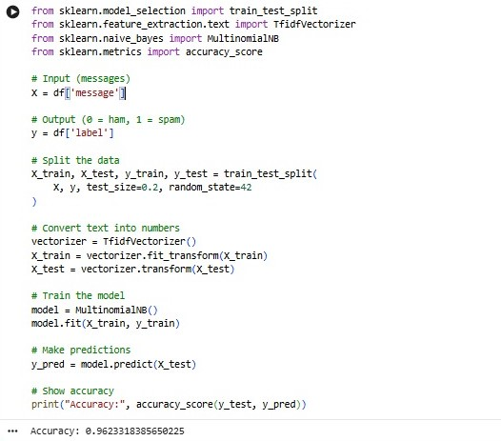

Experimental Results
96.28%
Model Classification Accuracy
High Accuracy Achieved: Out-of-sample testing yielded 96.28% precision on unseen messages.
Robust Performance: High F1-Score across both Spam and Ham message categories.

Slide 10
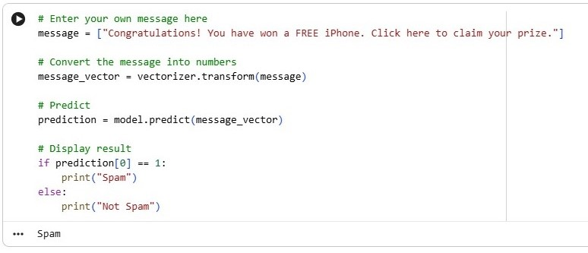
System Demonstration
1. Spam Prediction Demo

Slide 11
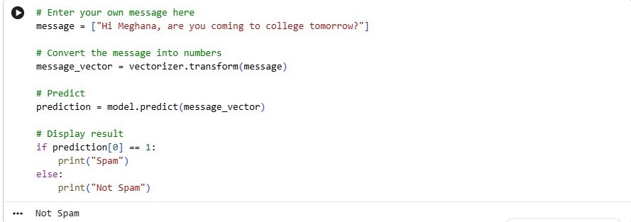
2. Not Spam (Ham) Demo

Slide 12
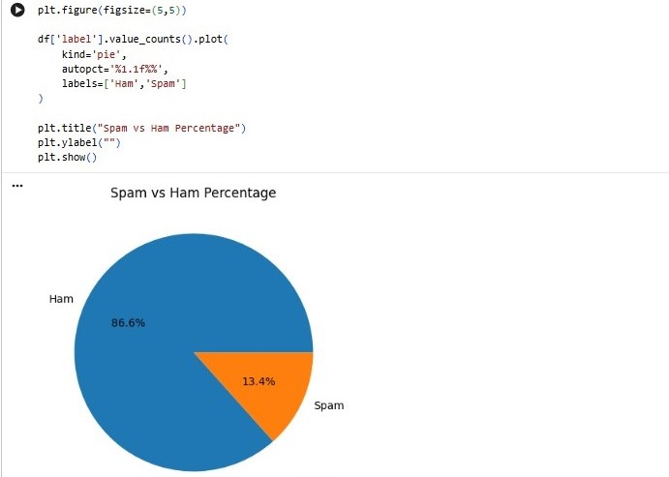
Sam vs Ham

Slide 13


Conclusion
Successful Detection: The developed Machine Learning pipeline successfully detects spam messages automatically.
High Performance Metric: Achieved an impressive overall accuracy rate of 96.28% using TF-IDF vectorization.
Project Outcome
The solution offers a lightweight, practical, and highly scalable spam detection framework ready for real-time application deployment.
Algorithm Fit: Proven that Multinomial Naive Bayes is highly effective, fast, and suitable for real-world text classification.

Slide 14
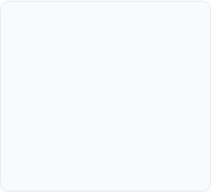
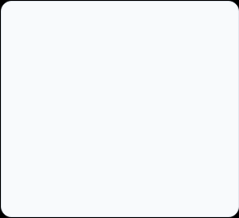
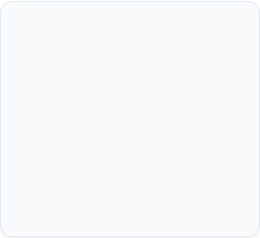

Future Scope
Phishing Email Detection
Multilingual Support
Deep Learning Models
App Deployment
Incorporate language detection to identify spam in regional and non-English languages.
Develop a user-friendly mobile app or web interface using Flask/Streamlit for real-time filtering.
Extend model capabilities to parse embedded malicious URL links and attachments in emails.
Explore Advanced Deep Learning architectures like LSTM, Bi-LSTM, and BERT transformers.

Slide 15
THANK YOU

